Slide 1
Simple Object Access Protocol

Slide 2
What is SOAP?
SOAP is a simple XML-based protocol to let applications exchange information over HTTP.
Stands for Simple Object Access Protocol
A communication protocol
For communication between applications
A format for sending messages
Communicates via Internet
Platform independent
Language independent
Based on XML
Simple and extensible
Allows you to get around firewalls
A W3C recommendation

Slide 3
Why SOAP?
Today's applications communicate using Remote Procedure Calls (RPC) between objects like DCOM and CORBA, but HTTP was not designed for this.
RPC represents a compatibility and security problem; firewalls and proxy servers will normally block this kind of traffic.

Slide 4
…Contd
SOAP provides a way to communicate between applications running on different operating systems, with different technologies and programming languages

Slide 5
SOAP Message
A SOAP message is an ordinary XML document containing the following elements:
An Envelope element that identifies the XML document as a SOAP message
A Header element that contains header information
A Body element that contains call and response information
A Fault element containing errors and status information

Slide 6
…contd
All the elements above are declared in the default namespace for the SOAP envelope:
http://www.w3.org/2001/12/soap-envelope
Default namespace for SOAP encoding and data types is:
http://www.w3.org/2001/12/soap-encoding

Slide 7
Syntax Rules
A SOAP message MUST be encoded using XML
A SOAP message MUST use the SOAP Envelope namespace
A SOAP message MUST use the SOAP Encoding namespace
A SOAP message must NOT contain a DTD reference
A SOAP message must NOT contain XML Processing Instructions

Slide 8
Skeleton of SOAP Message
<?xml version="1.0"?>
<soap:Envelope xmlns:soap="http://www.w3.org/2001/12/soap-envelope" soap:encodingStyle="http://www.w3.org/2001/12/soap-encoding"> <soap:Header> ... </soap:Header> <soap:Body> ... <soap:Fault> ... </soap:Fault> </soap:Body>
</soap:Envelope>

Slide 9
SOAP Envelope – Root Element
<?xml version="1.0"?> <soap:Envelope xmlns:soap="http://www.w3.org/2001/12/soap-envelope" soap:encodingStyle="http://www.w3.org/2001/12/soap-encoding"> ... Message information goes here ... </soap:Envelope>

Slide 10
SOAP Header
SOAP Header element can be explained as:
Header elements are optional part of SOAP messages.
Header elements can occur multiple times.
Headers are intended to add new features and functionality
The SOAP header contains header entries defined in a namespace.
The header is encoded as the first immediate child element of the SOAP envelope.
When more than one header is defined, all immediate child elements of the SOAP header are interpreted as SOAP header blocks.

Slide 11
…contd
The optional Header element offers a flexible framework for specifying additional application-level requirements.
For example, the Header element can be used to specify a digital signature for password-protected services;
it can be used to specify an account number for pay-per-use SOAP services.

Slide 12
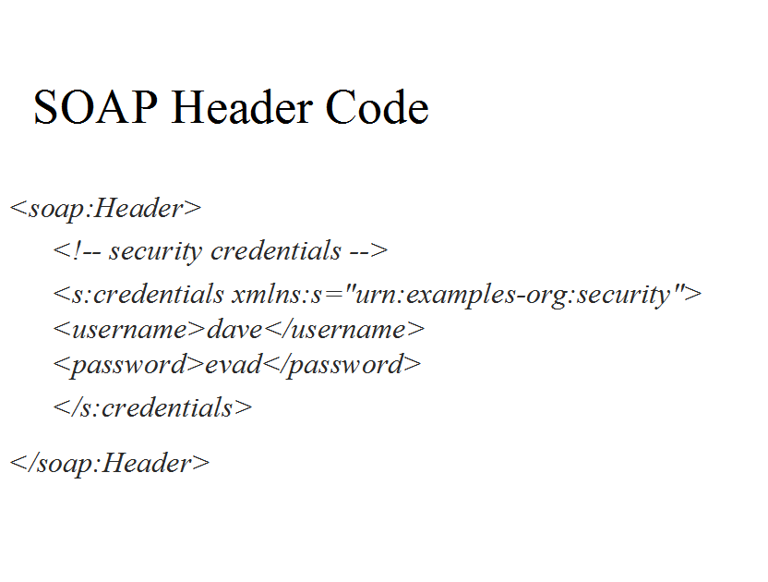

Slide 13
MustUnderstand attribute
Indicates whether a Header element is optional or mandatory.
If set to true ie. 1 the recipient must understand and process the Header attribute according to its defined semantics, or return a fault.

Slide 14
Example
<?xml version="1.0"?> <soap:Envelope xmlns:soap="http://www.w3.org/2001/12/soap-envelope" soap:encodingStyle="http://www.w3.org/2001/12/soap-encoding"> <soap:Header> <m:Trans xmlns:m="http://www.w3schools.com/transaction/" soap:mustUnderstand="1">234 </m:Trans> </soap:Header> ... ... </soap:Envelope>

Slide 15
SOAP actor attribute
A SOAP message may travel from a sender to a receiver by passing different endpoints along the message path.
However, not all parts of a SOAP message may be intended for the ultimate endpoint, instead, it may be intended for one or more of the endpoints on the message path.

Slide 16
Example
<?xml version="1.0"?> <soap:Envelope xmlns:soap="http://www.w3.org/2001/12/soap-envelope" soap:encodingStyle="http://www.w3.org/2001/12/soap-encoding"> <soap:Header> <m:Trans xmlns:m="http://www.w3schools.com/transaction/" soap:actor="http://www.w3schools.com/appml/">234 </m:Trans> </soap:Header> ... ... </soap:Envelope>

Slide 17
SOAP Request Message
Request for the price of apples.
Note that the m:GetPrice and the Item elements above are application-specific elements.
They are not a part of the SOAP namespace.
<?xml version="1.0"?> <soap:Envelope xmlns:soap="http://www.w3.org/2001/12/soap-envelope" soap:encodingStyle="http://www.w3.org/2001/12/soap-encoding"> <soap:Body> <m:GetPrice xmlns:m="http://www.w3schools.com/prices"> <m:Item>Apples</m:Item> </m:GetPrice> </soap:Body> </soap:Envelope>

Slide 18
SOAP Response Message
<?xml version="1.0"?> <soap:Envelope xmlns:soap="http://www.w3.org/2001/12/soap-envelope" soap:encodingStyle="http://www.w3.org/2001/12/soap-encoding"> <soap:Body> <m:GetPriceResponse xmlns:m="http://www.w3schools.com/prices"> <m:Price>1.90</m:Price> </m:GetPriceResponse> </soap:Body> </soap:Envelope>

Slide 19
SOAP Fault
The optional SOAP Fault element is used to indicate error messages.
If a Fault element is present, it must appear as a child element of the Body element.
A Fault element can only appear once in a SOAP message.

Slide 20
SOAP Fault Sub Elements
Sub Element | Description
<faultcode> | A code for identifying the fault
<faultstring> | A human readable explanation of the fault
<faultactor> | Information about who caused the fault to happen
<detail> | Holds application specific error information related to the Body element

Slide 21
SOAP Fault Codes
Error | Description
VersionMismatch | Found an invalid namespace for the SOAP Envelope element
MustUnderstand | An immediate child element of the Header element, with the mustUnderstand attribute set to "1", was not understood
Client | The message was incorrectly formed or contained incorrect information
Server | There was a problem with the server so the message could not proceed

Slide 22
HTTP Request & Response
Request
POST /item HTTP/1.1 Host: 189.123.255.239 Content-Type: text/plain Content-Length: 200
Successful Response
200 OK Content-Type: text/plain Content-Length: 200
Unsuccessful Response
400 Bad Request Content-Length: 0

Slide 23
SOAP HTTP Binding
POST /item HTTP/1.1 Content-Type: application/soap+xml; charset=utf-8
Content-Length header for a SOAP request and response specifies the number of bytes in the body of the request or response.
Content-Length: bytes

